Slide 1

Building Chatbots using SAP Conversational AI
TUXA Boot Camp

Slide 2
Workshop Agenda
Topic | Presenter | Duration
Day 1
A brief overview of the 3-days Workshop | Vinay Joshi | 60 minutes
Introduction to Chatbots and Natural Language Processing | Souvik Majumder
SAP Conversational AI and types of chatbots | Saurabh Gang
Building FAQ Chat bots | Saurabh Gang
Assignment: Help Desk chat bot for customers
Day 2
Building perform action bot | Shubendhu Raj
Building Transactional Chatbots using NodeJS | Souvik Majumder | 60 minutes
Assignment: A chat bot for placing orders at a restaurant
Day 3
Integrating chat bot in a web-application | Souvik Majumder | 60 minutes
Integrating chat bot in SAP Jam, Telegram and Facebook Messenger | Vinay Joshi
Assignment: TBD
Q & A Session

Slide 3




Know your Presenters
Vinay Joshi
Senior Consultant
EY GDS Consulting
Souvik Majumder
Consultant
EY GDS Consulting
Saurabh Gang
Consultant
EY GDS Consulting
Shubendhu Raj
Consultant
EY GDS Consulting

Slide 4
Day 1

Slide 5
Introduction to Chatbots and Natural Language Processing
Souvik Majumder
EY GDS Consulting

Slide 6
What is Text Mining ?

Slide 7

Text Mining
Process of deriving meaningful information from a text for further analysis.
Text Mining usually involves the process of structuring the input text, deriving patterns within the structured data, and finally interpreting and evaluating the output.

Slide 8

Need of Text Mining
With the advancement of technology, most of the data (approx. 85%) is in unstructured textual form.
Better techniques and algorithms are required to extract useful and interesting information from the large amount of generated textual data.
Hence the area of text mining and information extraction came into picture and helps for extracting useful and interesting information.

Slide 9
Natural Language Processing (NLP)

Slide 10

Natural Language Processing
“A part of AI which deals with understanding of human language (natural language) by a program.”

Slide 11
Applications of NLP
Cleanup, Tokenization
Information Retrieval and Extraction
Machine Translation
Stemming
Relationship Extraction
Automatic Paraphrasing
Lemmatization
Named Entity Recognition
Natural Language Generation
Part of Speech (PoS) Tagging
Sentiment Analysis
Reasoning over Knowledge Based
Query Expansion
Word Sense and Disambiguation
Question Answering System
Parsing
Text Similarity
Dialog Systems
Topic Segmentation and Recognition
Coreference Resolution
Image Captioning
Morphological Segmentation
Discourse Analysis
Other Multimodel Tasks

Slide 12









Basic Structure of an NLP Application
Contains the database of information needed to respond queries of customer request
Knowledge Base
(Source Content)
NLP Layer
(Natural Language)
Contains interaction history of chatbot and users
Data Storage
(Interaction History & Analytics)
Application Interface for interacting with the user
Translates user queries into information for appropriate responses

Slide 13
What are Chatbots ?

Slide 14
Chatbots
A chatbot is software that simulates human-like conversations with users via text messages on chat. Its key task is to help users by providing answers to their questions.
Chatbots allows organizations to engage personally with customers.
Helps in finding information or get something done in a seamless automated way simply by typing text-based commands.
Backend
Natural Language Processing
Data Mining
Machine Learning

Slide 15

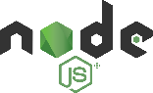





Chatbots behind the scenes
Your own Backend App
2
1
User’s Message
User’s Message
Bot’s Response
Bot’s Response
3
4
Bot Engine
Chat Platform

Slide 16
What are Bot Engines/ Frameworks ?

Slide 17
Bot Engines
Bot engines provide us with all the machine learning and natural language processing tools we'll need for creating chatbots.
They actually do all the "heavy lifting" for us.
We don’t have to write NLP codes and build chatbots from scratch.

Slide 18
SAP Conversational AI
Saurabh Gang
EY GDS Consulting

Slide 19
SAP Conversational AI
SAP Conversational AI is the ultimate end-to-end enterprise chatbot platform that enables us to train, build, connect and monitor chatbots to automate the employee experience.
Key Capabilities
Augmented Natural Language Processing
Support for Multiple Languages
Powerful Chatbot Development Suite
Leverage proprietary natural language processing (NLP) technology to analyse text inputs and enrich key data – for a rapid and straightforward deployment.
Interact with customers with the same level of accuracy in multiple languages. A trilingual bot can easily switch between languages during a conversation.
Draw on a comprehensive suite of chatbot tools to help the development process, from bot building to training.
Integration with SAP and Non-SAP Solutions
Leverage the Power of Data
Voice Activation
Connect you chatbot to any external communication channel, any SAP product, or any back-end system using bot connector functionality.
Understand your users through powerful analytics dashboard and perfect your training dataset through integrated analytics and benchmark tools.
Deploy voice-activated chatbots for Google Home, Alexa, and Cortana, in addition to text-activated bots.

Slide 20
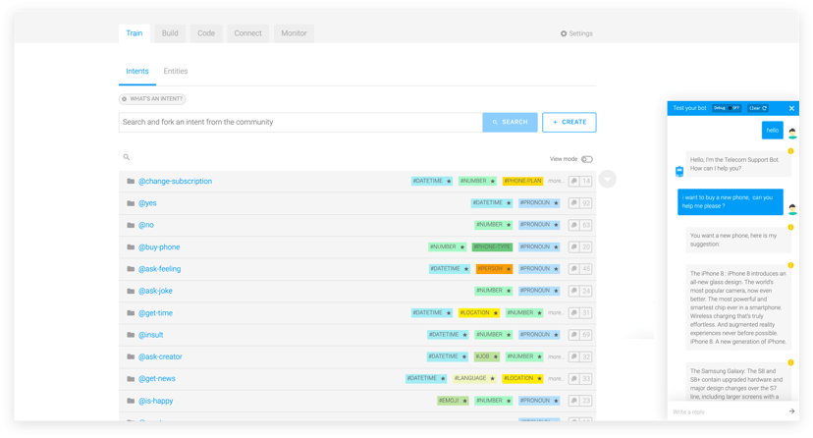
Benefits of SAP Conversational AI
Bots in any language
Easy to Use
Fastest Time to Market
Leverage the power of the highly performing NLP technology capable of building human-like AI chatbots in any language.
Simple UX, collaboration, organizational accounts, versioning and environments: makes this bot platform easy for all teams to use smoothly.
Through an efficient bot building process and a full integration to the SAP software suite, you can launch your bot in days.

Slide 21
Types of Chatbots

Slide 22
Walkthrough: CAI Platform Overview

Slide 23
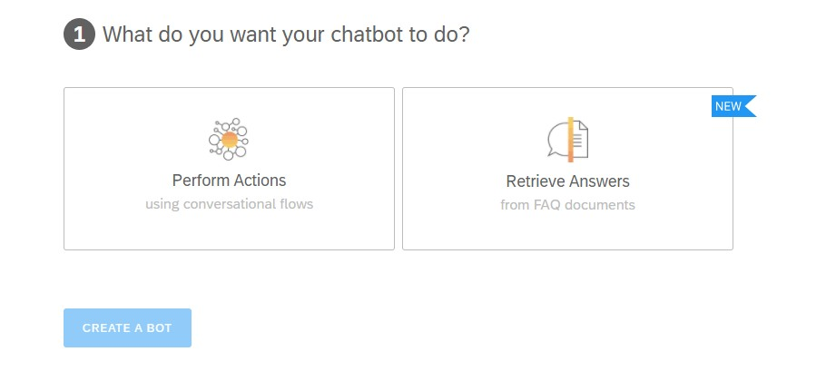
Types of Chatbots
There are two types of chatbot we can build in SAP Conversational AI Platform :
Perform Action (Transactional Bots)
Retrieve Answers (Knowledge Base / FAQ Chatbots)

Slide 24
Create an FAQ Chatbot

Slide 25
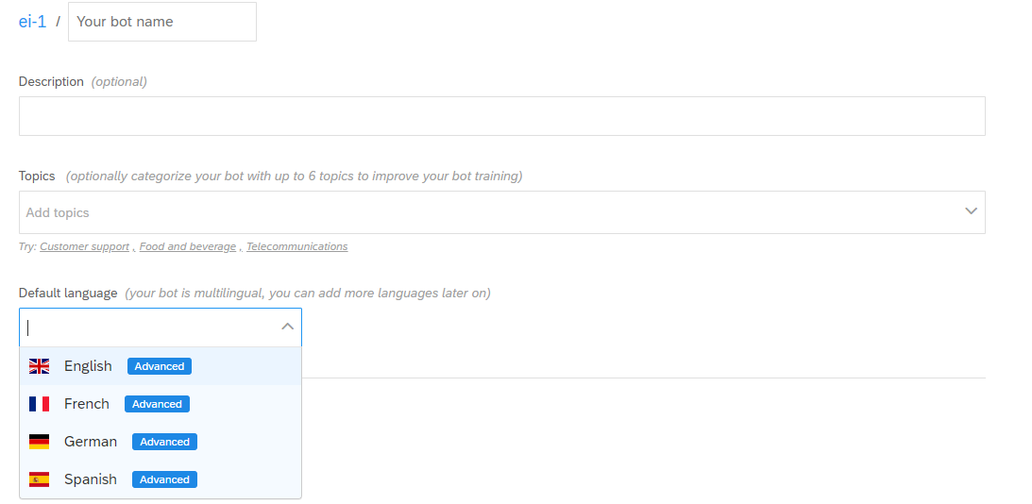
Create an FAQ Chatbot

Slide 26
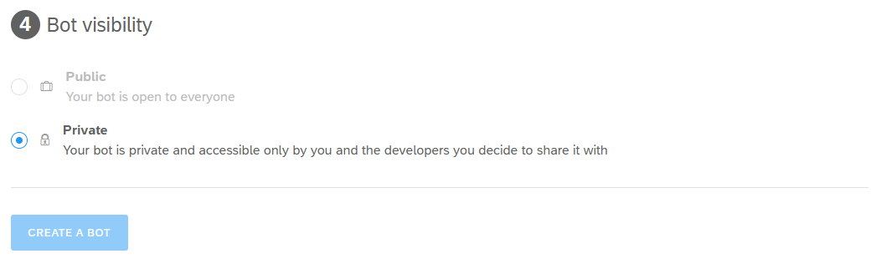
Bot Visibility

Slide 27
How to create an FAQ Bot
A FAQ bot retrieves answers to users’ questions from one or more documents (.csv file) that you upload. The document must include predefined pairs of questions and answers.
This allows your bot to map the user’s query to the best match and retrieve an answer without interpreting the intent of the question.
Upload your document:
Once you’ve created your bot, it will open on the train tab, where you can upload your FAQ files (CSV extension).
Document Requirements for FAQ File:
The file is a UTF-8 encoded CSV file.
Your file has either comma, semicolon, or pipe separated values, based on the default settings maintained in your computer
Your file size is no more than 10 MB
Your document has no more than 20,000 questions and answers.
Answers have no more than 2000 characters.
Questions have no more than 500 characters
The FAQ file has two columns: one for questions and one for answers.
You have used Markdown syntax for adding hyperlinks to text.

Slide 28
End of Day 1

Slide 29
Day 2

Slide 30
Perform-Action Chatbots
Shubendhu Raj
EY GDS Consulting

Slide 31







Perform-Action Chatbots
There are two types of Perform Action Bot in SAP Conversational AI
1. Static Chatbot: These bots always gives a static reply to a particular query.
Bot Engine
Chat Platform
2. Transactional Chatbot: These bots are connected using web hook call to backend. There replies are based on the data coming from the backend.
Your own Backend App
2
1
3
4
Bot Engine
Chat Platform

Slide 32
What are Intents ?

Slide 33
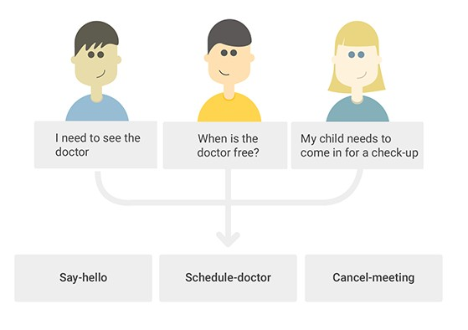
Intents
An intent is a set of expressions that mean the same thing, but are constructed in different ways.
Intents are central to your bot’s understanding. Each one of your intents represents an idea that your bot is able to understand.
You can add as many intents to your bot as you wish.
Expression 1
Expression 2
Intent 1
Expression 3
Expression 1
Expression 2
Intent 2
Expression 3

Slide 34
What are Entities ?

Slide 35
Entities
An entity is a keyword that is extracted from an expression.
We automatically detect 28 different entities (Gold entities) such as Datetime, Location, Person, and so on.
cardinal | email | language | number | percent | temperature
color | emoji | location | ordinal | person | url
datetime | ip | mass | organization | set | volume
distance | interval | money | phone | sort
duration | job | nationality | pronoun | speed

Slide 36
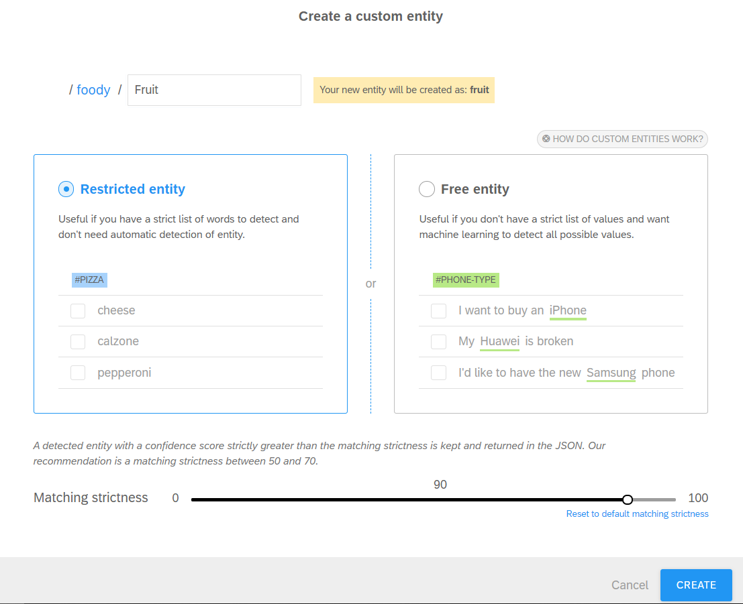
Entities
We can also tag our own Custom entities to detect keywords depending on our bot’s context: for example, subway stations if you’re building a transport assistant.

Slide 37
What are Skills ?

Slide 38
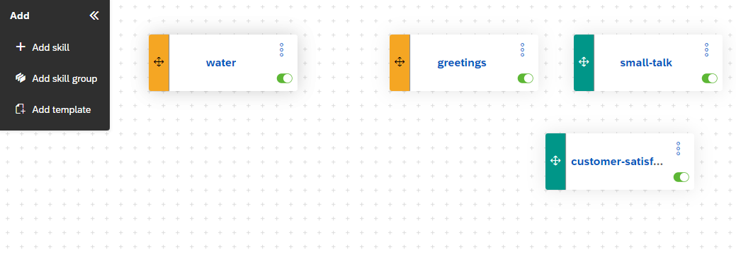
Skills
A skill is a block of conversation that has a clear purpose and that your bot can execute to achieve a goal.
It can be as simple as the ability to greet someone, but it can also be more complex, like giving movie suggestions based on information provided by the user.
You can add a skill to your bot on the Build tab by clicking Add skill in the command panel on the left. You can add as many skills to your bot as you wish.

Slide 39
Types of Skills
Skill type | Description
Fallback | Skill that is triggered if no other skill is triggered. Your bot can only have one fallback skill. So when you add a skill to your bot, the skill type Fallback is offered only if your bot doesn't already have a fallback skill.
Disambiguation | Skill that is triggered during a conversation in case multiple skills are resolved. If the disambiguation skill is deactivated the fallback skill is triggered.
Business | Skills that are closely linked to the core purpose of your bot.
Floating | Small-talk skills, that is, topics that are not closely related to the core purpose of your bot.

Slide 40
What are Actions ?

Slide 41
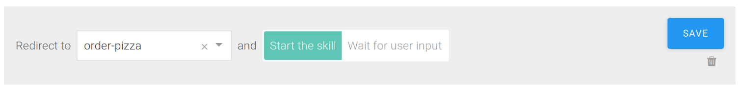
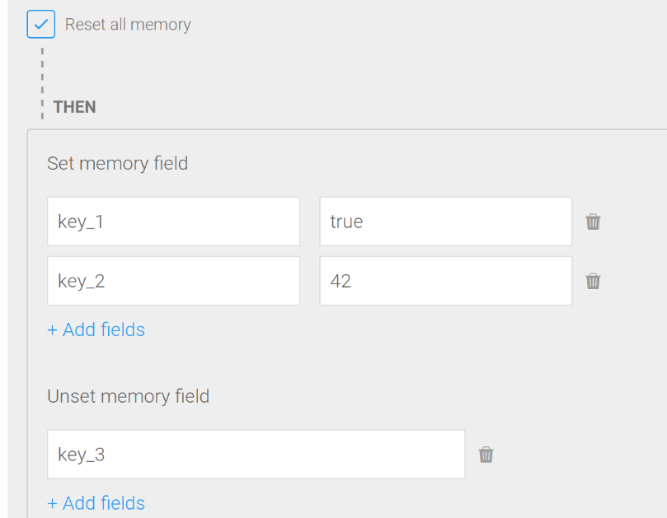
Actions
An action is something that your bot executes at a specific point when executing a skill. To add actions to a skill, open the skill on the Build tab and then go to Actions and click ADD NEW MESSAGE GROUP.
Action Categories: - Go to another skill
- Edit the bot’s memory for the current conversation

Slide 42
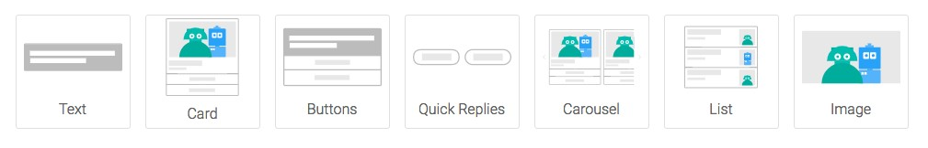
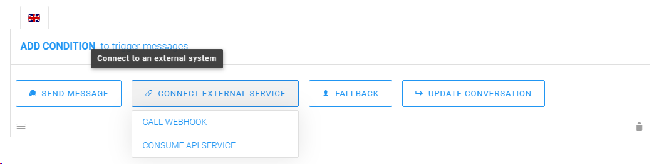
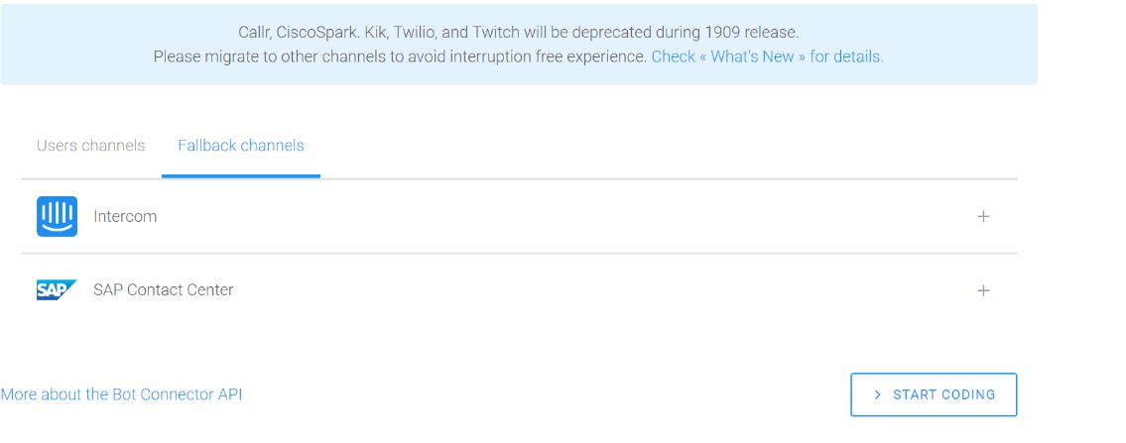
Actions
- Send message to the user - Connect external service - Fallback (that is, redirect the conversation to a human agent)

Slide 43

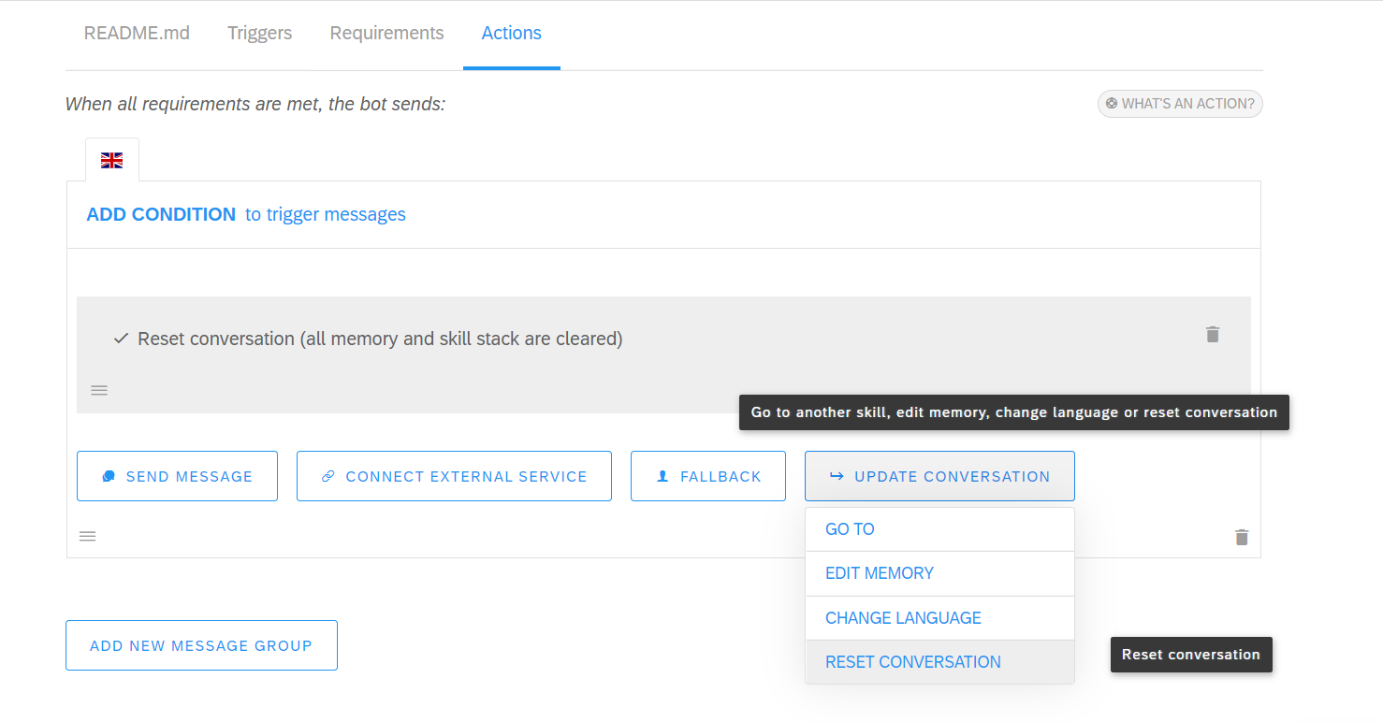
Actions
- Change Language
- Reset Conversation

Slide 44
Demo: Create a Perform-Action Static Chatbot

Slide 45
Introduction to NodeJS
Souvik Majumder
EY GDS Consulting

Slide 46


Node JS
Node.js is an open-source, cross-platform, back-end, JavaScript runtime environment that executes JavaScript code outside a web browser.
Node.js lets developers use JavaScript to write command line tools and for server-side scripting and running scripts server-side
Single-threaded, non-blocking, asynchronously programming, which is very memory efficient.
Ryan Dahl
Developer of Node.js

Slide 47
Node.js Installation

Slide 48
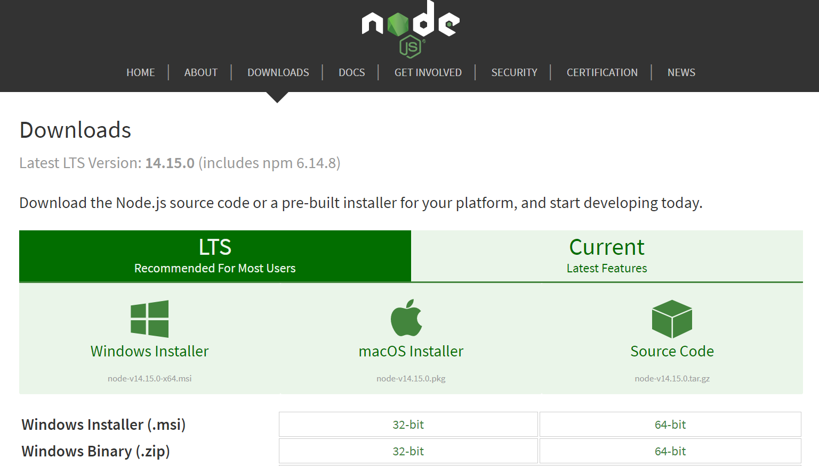
Installing Node JS
Download Node.js from the official website https://nodejs.org/en/download/
Verify your Node.js installing by running the following command in Command Prompt

Slide 49
Node.js NPM

Slide 50
Configuring Node JS SDK for SAP Conversational AI

Slide 51
Configuring Node JS SDK for SAP Conversational AI
Navigate to the desired location in the system and Clone the Node JS Reusable code template from the GIT Repository, by executing the command below through Command Prompt. git clone https://github.com/E-equals-mcsquare/SAP-CAI-Node-SDK.git
Navigate inside the SAP-CAI-Node-SDK directory.
Run the command npm install to install all the necessary npm modules.
Open Visual Studio Code or any editor of your choice.

Slide 52
What is NGROK ?

Slide 53
What is NGROK ?
Ngrok exposes local servers behind NATs and firewalls to the public internet over secure tunnels.
To download ngrok, go the link https://ngrok.com/download
Easy HTTPS
Instantly create a public HTTPS url for a website running locally on your development machine. ngrok offloads TLS so you don't have to worry about your configuration.
Fast & Reliable
ngrok tunnels run using an optimized version of the technology that powers HTTP/2 so that your tunnelled services load fast. ngrok runs in multiple regions and availability zones around the globe, ensuring that your tunnels are always online.
Access from Anywhere
Traffic is relayed through to the ngrok process running on your machine and then on to the local address you specified.
Authenticated Access
Set HTTP auth credentials to protect access to your tunnel and those you share it with. ngrok also supports other authentication methods. Add OAuth to your endpoints automatically; no code required.

Slide 54
End of Day 2

Slide 55
Day 3

Slide 56
Demo: Build a Transactional Chatbot for Products

Slide 57
Integration to External Messaging Channels
Vinay Joshi
EY GDS Consulting

Slide 58
End of Day 3

